Slide 1
Comprehensive Digital Marketing
Project Work

Slide 2
TOPIC: HALDIRAM’s
SUBMITTED BY,
TEAM ID: LTVIP2023TMID08539
TEAM LEADER: PUJYAM SRAVANI
TEAM MEMBERS:
DOBBA GYANESWAR
P. VENKATA LAKSHMI
CHOPPARLA VIVEK
AMBATI HARSHA

Slide 3
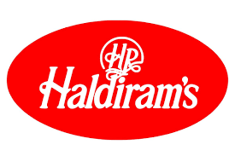
Part 1: Brand study, Competitor Analysis & Buyer’s/Audience’s Persona
Research On Brand Identity: Haldiram Limited is an unlisted public company incorporated on 06 October, 1997. It is classified as a public limited company and is located in Kolkata, West Bengal. It's authorized share capital is INR 3.00 cr and the total paid-up capital is INR 2.24 cr.
Description: The company manufactures sweets & namkeens.
Products & Services: NAMKEEN, PAPADS, SWEETS, BISCUITS, DRINKS, FESTIVE PACKS
Brand colours: Red & Blue
Logo:
Mission/Values: Review, recreate & rediscover the trend of healthy eating, innovate and invent fresh new methods to nourish and delight everyone we serve.
Vision: Be the trend setter in the field of healthy and tasty eating to achieve a sustainable growth. This will bring about an overall upliftment of the organization, its people & the society.
Goal: To provide our customers perfect state & quality in best of packaging.
USP: The USP of Haldiram’s is providing wide range of hygienic, tasty and authentic Indian savories and sweet.

Slide 4
Part 1: Brand study, Competitor Analysis & Buyer’s/Audience’s Persona
Analyze Brand Messaging:
Haldirams is one of the leading brands in the food & beverages sector. Haldiram's is an Indian multinational sweets, snacks and restaurant company headquartered in Noida. The company has manufacturing plants in a wide variety of locations such as Nagpur, New Delhi, Gurgaon, Hooghly, Rudrapur and Noida. Haldiram's has its own retail chain stores and a range of restaurants in Pune, Nagpur, Raipur, Kolkata, Noida and Delhi. Products. Haldiram's has over 410 products. Its product range includes traditional namkeens, western snacks, Indian traditional and contemporary Sweets, cookies, sherbets, and pickles. Products such as gulab jammun and Bikaneri bhujia and papadum are popular.
Examine the brand's tagline: “Delicious bhi Dooriyaan bhi”
Through the tagline “Delicious bhi Dooriyaan bhi” the brand emphasises on the seating arrangement where consumers are requested and restricted to maintain 6 feet distance from individuals to create a temporary practise of social distancing for safe dining experience and to maintain the permanent love of Haldiram's.
Category | Food Products & Restaurant
Sector | Food & Beverages
Segmentation | Anyone who can use a snack like savories, sweets, etc.
Target Market | Middle class families (especially women and kids)
Positioning | As a tasty, hygienic savories and sweet maker

Slide 5
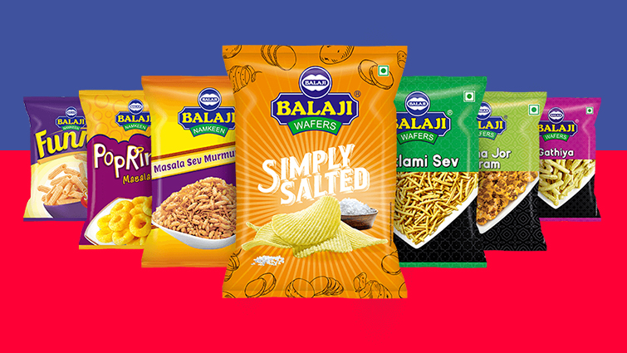
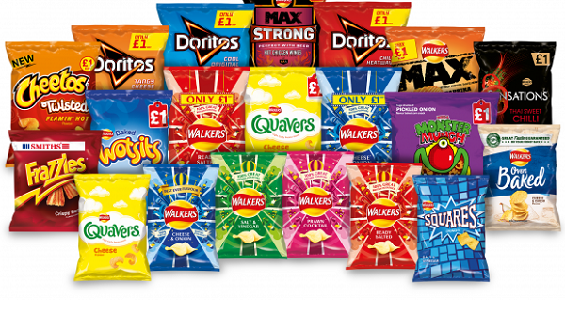
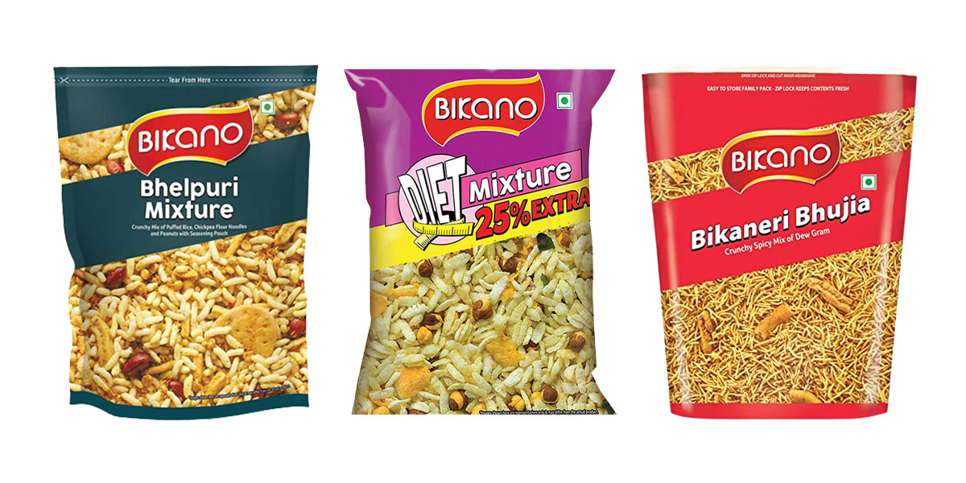
Part 1: Brand study, Competitor Analysis & Buyer’s/Audience’s Persona
Competitor Analysis: Select three competitors operating in the same industry or niche as the chosen brand, examine their USPs and online communication.
Competitor 1
BALAJI: https://www.balajiwafers.com/products/
USP: Tasty & delightful snacks in lots of flavours and in different shapes & styles
Communication: Social Media Ads, Value based content, Brand collabrations
Competitor 2
PEPSICO: https://www.pepsico.com/our-brands/creating-smiles/our-products#
USP: Tasty wafers for the youth with huge number of flavors
Communication: User generated content, Celebrity endorsements, Relatable content &memes
Competitor 3
BIKANO: https://www.bikano.com/
USP: Good quality, fresh, hygienic and tasty Indian sweets and snacks
Communication: Brand collabratioins, Tips & tricks, Value based content.

Slide 6
Part 1: Brand study, Competitor Analysis & Buyer’s/Audience’s Persona
COMPETITOR ANALYSIS: The following table represents the comparison between similar industry businesses along with haldiram’s on the following basis
BASIS | PROJECT TOPIC | COMPETITOR 1 | COMPETITOR 2 | COMPETITOR 3
COMAPANY NAME | HALDIRAM’s | BALAJI | PEPSICO | BIKANO
TAG LINE | Delicious bhi Dooriyaan bhi | Wafers Zyaada, Flavours WahWah | That's what I like | Hum se behtar bhujia ko jaane kaun Sab Kahte Hain
CAPITAL | authorized capital: INR 139.00 cr paid-up capital: INR 11.80 cr | authorized capital: INR 55.00 cr paid-up capital: INR 52.90 cr | authorized capital: ₹ 4,000.00 cr paid-up capital: ₹ 3,468.79 cr | Paid-up Capital: 1218.23 lakhs Authorized Capital: 1500.0 lakhs
REVENUE | revenues range is Over INR 500 cr for the financial year ending on 31 March, 2022. | revenues range is Over INR 500 cr for the financial year ending on 31 March, 2022. | revenues range is Over INR 7069.69 cr for the financial year ending on 31 March, 2022. | Rs 1,250 crore in the financial year ending March 31, 2022
PRICING STRATEGY | Competitive pricing | Penetrative pricing | Value based pricing | Skimming strategy
MARKETING STRATEGY | 4P’s of Marketing | 4P’s of Marketing | 4P’s of Marketing | 4P’s of Marketing
RATINGS OF THE PRODUCTS | 5/5 | 4.8/5 | 4.1/5 | 4.3/5

Slide 7
Part 1: Brand study, Competitor Analysis & Buyer’s/Audience’s Persona
Buyer's/Audience's Persona: Mainly, haldiram’s target audience were MIDDLE CLASS FAMILIES ( Esp; Women & Kids ).
A buyer's persona is a fictional representation of the ideal customer for a specific business or brand. In the case of Haldiram's, a well-known Indian snacks and sweets brand, here is a buyer's persona on the following 4 aspects:
DEMOGRAPHICS:
Age: Haldiram's target audience primarily includes individuals of all age groups, from children to seniors. Different product categories cater to various age segments.
Gender: Both males and females enjoy Haldiram's products, as they offer a wide range of snacks and sweets that appeal to diverse preferences.
Location: While Haldiram's has a global presence, its primary target audience is individuals residing in India and the Indian diaspora around the world.
Income: The brand caters to a broad range of income levels, offering affordable snacks for budget-conscious consumers and premium options for those seeking luxury treats.
PSYCHOGRAPHICS:
Indian Cuisine Enthusiasts: Haldiram's appeals to individuals who appreciate and cherish the authentic flavors of Indian cuisine and are keen to explore traditional delicacies.
Health-Conscious Consumers: With an increasing focus on healthier snacking options, Haldiram's has adapted its product range to include low-fat and gluten-free alternatives, appealing to health-conscious consumers.
Celebration and Festivity Lovers: Haldiram's products are popular choices during festivals, celebrations, and special occasions, attracting individuals looking to add a touch of tradition and joy to their gatherings.

Slide 8
BEHAVIOURS:
Repeat Buyers: Haldiram's has a loyal customer base, with people often coming back for their favorite snacks and sweets.
Occasional Indulgers: While some customers buy Haldiram's products regularly, others indulge occasionally, making purchases during festivals, family gatherings, or as gifts.
Online Shoppers: With the rise of e-commerce, Haldiram's targets customers who prefer the convenience of online shopping to purchase their products.
INTERESTS:
Indian Culture and Heritage: Those interested in exploring Indian culture and heritage through its culinary offerings are likely to be drawn to Haldiram's.
Foodies and Snack Enthusiasts: Haldiram's appeals to food enthusiasts, especially those with a penchant for snacks, sweets, and traditional Indian delicacies.
Overall, Haldiram's target audience encompasses a wide spectrum of individuals, united by their appreciation for the rich flavors of Indian cuisine. The brand caters to various age groups, income levels, and interests, making it a versatile choice for consumers looking to experience the essence of Indian culinary delights.

Slide 9
Part 1: Brand study, Competitor Analysis & Buyer’s/Audience’s Persona
BUYER’s PERSONA: SURVEYED 2 PERSONS ON THE FOLLOWING ASPECTS
BASIS | PERSON 1 | PERSON 2
PERSONAL DETAILS | Name: Lalitha, Age: 47, Occupation: House wife, Location: hyderabad, India., Marital Status: Married, with two kids, Income Level: Upper-middle class | Name: Rithvika, Age: 10, Grade: 5, Location: hyderabad, India.
BACKGROUND | Lalitha is a housewife who takes care of her family & home. She values her family time & tries to balance all over work load. Lalitha & her family are health-conscious and prefer to have home-cooked meals most of the time. However, they also enjoy indulging in snacks and sweets during weekends or on special occasions. | Rithvika is a lively and curious 10-year-old girl living in a middle-class family in Hyderabad. She is a student in the 5th grade, where she enjoys learning about various subjects, especially science and history. Rithvika is an active and playful child, and she loves spending time with her friends after school.
SHOPPING BEHAVIOUR | Quality Conscious, Convenience, Occasional Treats, Gifting, Online Shopping | Snack Lover, Occasional Treats, Colorful Packaging, Gift Excitement, Peer Influence
PREFERENCES | Wide Variety, Healthy Options, Authentic Indian Flavors, Competitive Pricing | Fun Shapes and Flavors, Sweet and Savory Balance, Ready-to-Eat
MARKETING INFLUENCE | Word-of-mouth, Digital Advertising, Festive Promotions | TV Commercials, Packaging Design, Seasonal Themes
CONCLUSION | Overall, Lalitha represents a typical buyer's persona for Haldiram's - a quality-conscious, health-conscious, and family-oriented individual who values convenience and authenticity when it comes to snacks and sweets. Understanding such buyer personas helps businesses tailor their marketing strategies and product offerings to better meet the needs and preferences of their target audience. | Overall, Rithvika represents a typical buyer's persona of a kid for Haldiram's - a fun-loving, adventurous, and snack-loving child who enjoys treats with exciting shapes and flavors. Understanding such buyer personas helps brands like Haldiram's create products and marketing strategies that cater to the preferences of their younger audience.

Slide 10
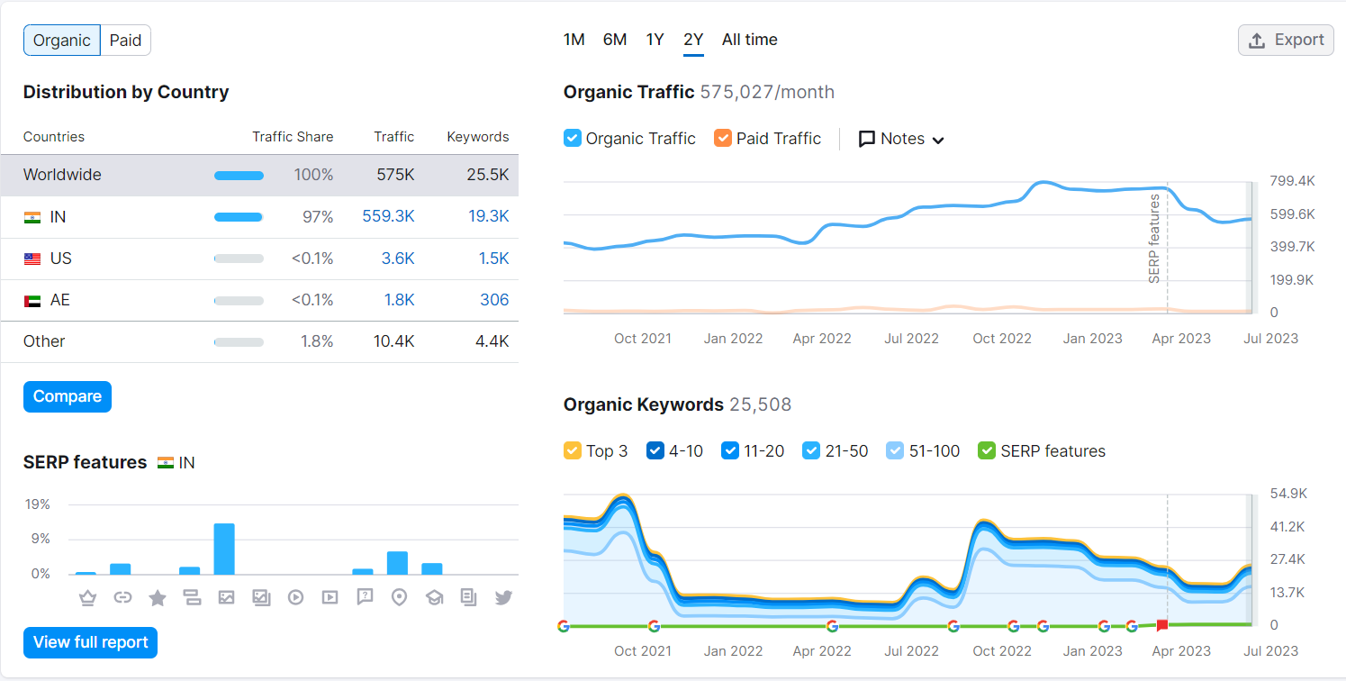
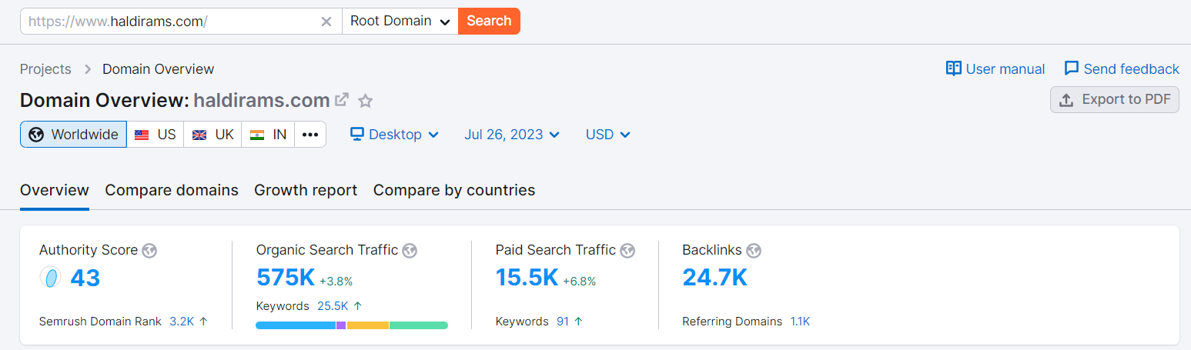
Part 2: SEO & Keyword Research
Search Engine Optimization of Haldiram’s

Slide 11
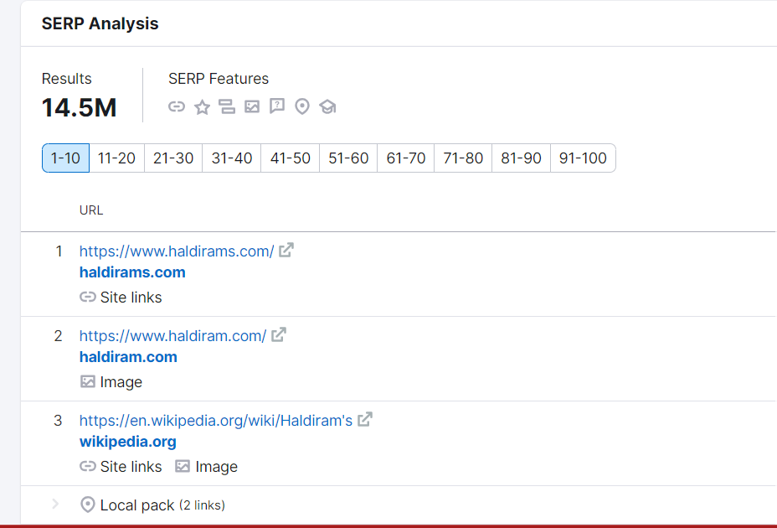
Search Engine Optimization of Haldiram’s

Slide 12
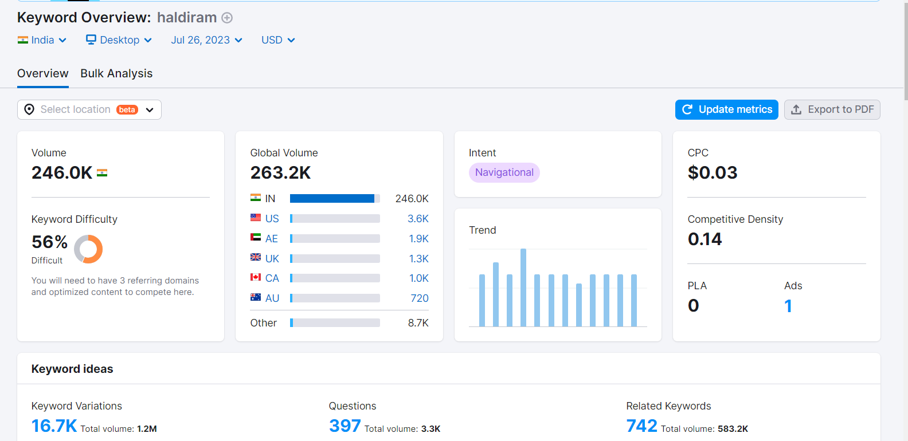
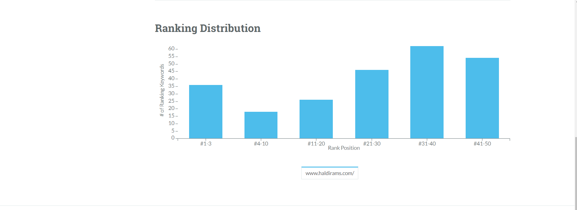
Part 2: SEO & Keyword Research
Keyword Research of Haldiram’s

Slide 13
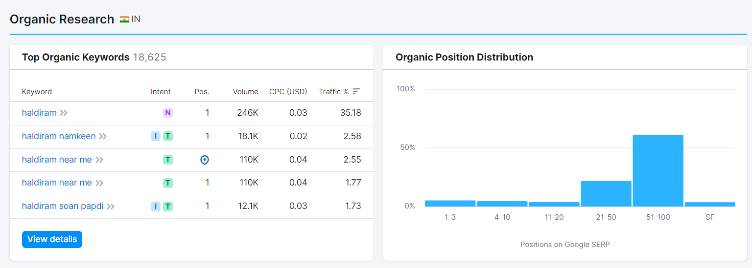
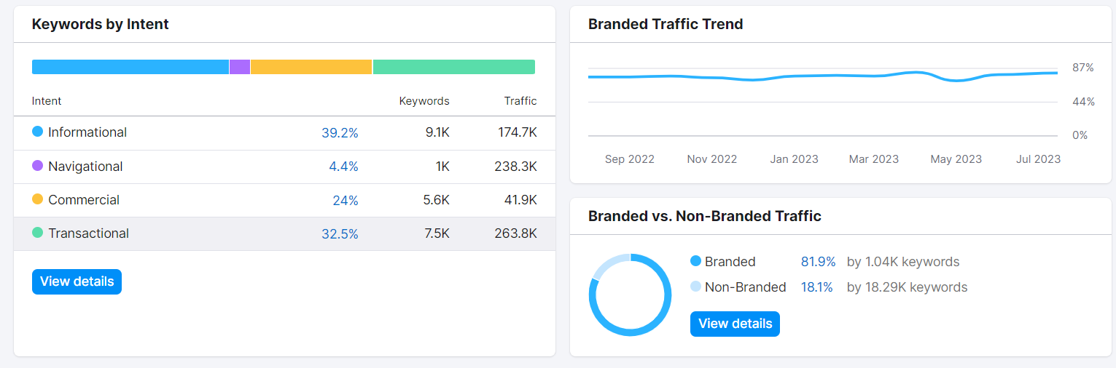
Keyword Research of Haldiram’s

Slide 14
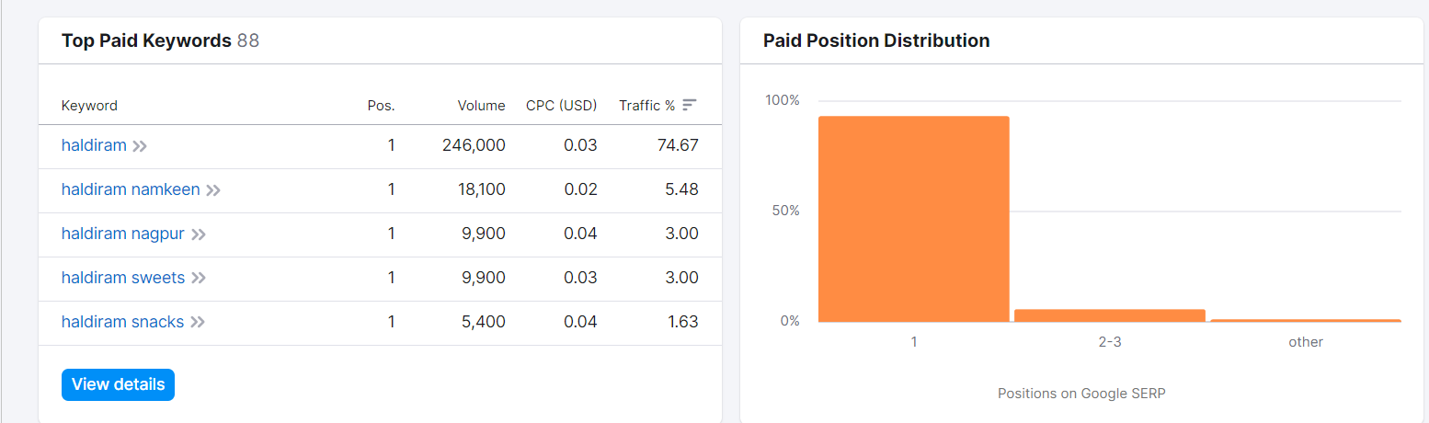
Keyword Research of Haldiram’s

Slide 15
Part 2: SEO & Keyword Research
On-Page Optimization of Haldiram’s
Meta Title: "Haldiram's: Authentic Indian Snacks & Sweets Since 1937"
Meta Description: "Discover the rich heritage of Haldiram's, offering a delightful range of authentic Indian snacks and sweets since 1937. Indulge in the finest flavors and traditional recipes crafted with love and perfection, delivered worldwide."
Content:
1. Experience the Exquisite Delights of Haldiram's: Authentic Spices, Snacks, and Sweets:
At Haldiram's, we take pride in crafting an unparalleled gastronomic experience, where authentic spices, delectable snacks, and delightful sweets come together to tantalize your taste buds. With a legacy spanning over eight decades, Haldiram's has become synonymous with quality, taste, and tradition.
2. Authentic Spices:
Our journey begins with the heart of Indian cuisine - the spices. With a meticulous selection process and dedication to preserving the true essence of flavors, we source the finest and authentic spices from different regions of India. From the aromatic richness of cumin and coriander to the fiery kick of red chili and the warmth of cardamom, our spice blends are a tribute to the diverse and vibrant culinary tapestry of India.
3. Delectable Snacks:
Step into the world of Haldiram's snacks, where each bite is a burst of flavors. Our snacks are a perfect amalgamation of age-old recipes and modern techniques, ensuring that you get to experience the authentic taste of India in every morsel. From crispy and savory samosas to crunchy and tangy bhujia, our snack collection caters to every palate, leaving you craving for more.
4. Delightful Sweets:
Indulge your sweet tooth with our delightful selection of Indian sweets. Prepared with love and care, our sweets encapsulate the essence of festivities and celebrations. From the rich and creamy texture of rasgulla to the exotic flavors of kaju katli, each sweet is a celebration of the artistry and craftsmanship that goes into creating them.
5. An Enchanting Journey:
At Haldiram's, we invite you on an enchanting journey through the flavors of India. With every product we offer, we aim to bring you the warmth and hospitality that Indian culture is known for. Each bite tells a story of tradition passed down through generations, where flavors are cherished, and culinary heritage is celebrated.
6. The Haldiram's Promise:
With a commitment to quality and customer satisfaction, Haldiram's ensures that every product meets the highest standards of taste and hygiene. We take immense pride in sharing the true essence of Indian spices, snacks, and sweets with the world.
So, whether you are craving the perfect snack to accompany your evening tea or seeking to add a touch of sweetness to your celebrations, Haldiram's has a treat for every occasion. Come, experience the magic of authentic spices, snacks, and sweets, as we embark on a gastronomic journey together.

Slide 16
Part 2: SEO & Keyword Research
On page Optimization: Document the challenges faced during the research and analysis phase, as well as the key insights gained from the keyword research process.
Research and Analysis Phase Challenges:
Data Availability: One of the primary challenges during the research and analysis phase is the availability of relevant and reliable data. Depending on the topic, certain information might be scarce or outdated, making it difficult to draw accurate conclusions.
Data Quality: Ensuring the quality and credibility of the data used for research is crucial. Poorly sourced or inaccurate data can lead to flawed analysis and unreliable insights.
Complexity of the Topic: Some research topics can be inherently complex, requiring a deep understanding of specialized knowledge or technical expertise. Dealing with such intricate subjects can slow down the research process and make it more challenging to arrive at meaningful conclusions.
Time Constraints: Research and analysis can be time-consuming, especially when dealing with vast amounts of data or when trying to identify patterns and trends. Time constraints can limit the depth of analysis or lead to rushed decisions.
Conflicting Information: In the course of research, conflicting information from different sources can arise. Researchers must carefully evaluate the credibility and validity of each source to ensure accurate and consistent findings.
Multidisciplinary Nature: Some research topics may require knowledge from various disciplines, making it essential to collaborate with experts from different fields. Coordinating efforts and integrating diverse perspectives can be a challenging task.
Ethical Considerations: Research involving sensitive topics or data must navigate ethical considerations and ensure the privacy and consent of individuals involved.
Budgetary Constraints: In some cases, the lack of sufficient funds may limit access to certain data sources or tools, hindering the depth and scope of the research.

Slide 17
Here are some key insights that can be gained from the keyword research process:
Search Volume and Trends: Keyword research helps identify the popularity and search volume of specific keywords over time. This insight can guide content creation and marketing strategies to target topics with higher search demand.
User Intent: Analyzing keywords can reveal user intent, i.e., what users are looking for when they enter a particular search query. Understanding user intent allows businesses to tailor their content to match what the audience wants, increasing the likelihood of engagement and conversions.
Competitor Analysis: Keyword research unveils the keywords that competitors are targeting. This information allows businesses to identify gaps in their content strategy and discover new opportunities to target relevant keywords.
Long-tail Keywords: Long-tail keywords are specific, niche search terms that have lower search volume but higher intent. Keyword research helps identify these long-tail opportunities, which can be valuable for attracting highly targeted and motivated traffic.
Seasonal Trends: Through keyword research, seasonal trends can be identified, enabling businesses to plan their content and marketing campaigns around specific times of the year when demand is higher.
Geographical Insights: Keyword research can provide insights into location-specific search trends, allowing businesses to optimize content for regional or local audiences.
Content Ideas: Keyword research often generates new content ideas based on the questions and topics people are searching for. This helps businesses stay relevant and create content that addresses their audience's needs.
Keyword Difficulty: Assessing keyword difficulty helps prioritize keywords that are relatively easier to rank for. This can be especially beneficial for newer websites or those with limited resources.
Language and Terminology: Keyword research can reveal the language and terminology used by the target audience, ensuring that content and marketing efforts resonate with them.
Overall, keyword research is a powerful tool for understanding the online landscape, optimizing content, and developing effective digital marketing strategies. It empowers businesses to make data-driven decisions and improve their online visibility and engagement.

Slide 18

Part 3: Content Ideas and Marketing Strategies
Week 1:
August 1st: National Friendship Day – Instagram story
August 3rd: International Beer Day – Instagram post
August 5th: Blog Article
Week 2:
August 8th: International Cat Day –Youtube Video
August 10th: World Lion Day – Instagram Story
Week 3:
August 13th: Ad campaign
August 15th: Indian Independence Day – Facebook Story
August 18th: Raksha Bandhan – Instagram Post
Week 4:
August 21st: Instagram Reel
August 23rd: Blog Article
August 25th: Ganesh Chaturthi – Ad campaign buy 1 get 2 free
August 30th: Youtube short
August 30th: International Bacon Day – Facebook post

Slide 19
Part 3: Content Ideas and Marketing Strategies
Content Ideas for Haldirams
Create engaging and valuable content is essential to attract and retain the attention of your audience. For Haldiram's, a popular Indian snack and sweets brand, here are some content ideas that can help showcase their products, culture, and connect with their target audience:
Recipe Showcase: Share delicious and creative recipes that incorporate Haldiram's products as ingredients. For example, you can create recipes like "Haldiram's Bhel Puri Chaat" or "Haldiram's Gulab Jamun Trifle."
Product Reviews and Comparisons: Write detailed reviews of Haldiram's products, highlighting their taste, quality, and uniqueness. You can also compare different products within their range to help customers make informed choices.
Behind-the-Scenes at Haldiram's: Offer a glimpse into the behind-the-scenes operations of Haldiram's. This could include interviews with chefs, factory tours, or stories about the brand's history and values.
Festive and Seasonal Specials: Create content around Indian festivals and seasons, suggesting how Haldiram's products can be a part of the celebrations. For instance, "Diwali Sweets Collection by Haldiram's" or "Monsoon Snacks to Enjoy with Haldiram's."
Health and Nutrition Tips: Share articles or videos about the nutritional aspects of various Haldiram's products, emphasizing healthier snack options and how they fit into a balanced diet.
Customer Spotlights: Feature stories or testimonials from customers who love Haldiram's products, showcasing how the brand has made a positive impact on their lives.
Interactive Quizzes and Polls: Create fun quizzes and polls related to Indian snacks and sweets, incorporating Haldiram's products. For example, "Which Haldiram's Namkeen Are You?" or "Favorite Haldiram's Dessert."
Regional Cuisine Exploration: Dive into the diverse regional cuisines of India and how Haldiram's offers a wide range of snacks and sweets from different parts of the country.
Cooking Tips and Hacks: Offer cooking tips and hacks using Haldiram's products, such as quick and easy recipes or creative ways to use their snacks in dishes.
DIY Gift Ideas: Provide DIY gift ideas using Haldiram's festive gift packs or assortments for special occasions like birthdays, anniversaries, or holidays.
Contests and Giveaways: Organize contests and giveaways on social media platforms where participants can win Haldiram's gift hampers or vouchers.
Travel and Food Adventure: Combine travel and food by showcasing how Haldiram's products can be enjoyed on road trips, picnics, or outdoor adventures.
Remember to tailor the content to your target audience's preferences and interests. Utilize various content formats such as blog posts, videos, infographics, and social media posts to keep the content engaging and diverse. Additionally, consider collaborating with influencers or food bloggers to expand the reach of your content.

Slide 20
Marketing Strategies for Haldirams
Haldiram's is a well-established and popular brand, but to maintain and expand its market presence, it can adopt several marketing strategies. Here are some effective marketing strategies for Haldiram's:
Digital Marketing Campaigns: Invest in digital marketing to reach a wider audience. Utilize social media platforms, search engine marketing (SEM), display ads, and email marketing to promote products, share content, and engage with customers.
Content Marketing: Create valuable and engaging content around Indian snacks and sweets, recipes, cultural aspects, and the Haldiram's brand. This can include blogs, videos, infographics, and social media posts.
Influencer Marketing: Collaborate with food influencers and celebrities to promote Haldiram's products. Influencers can showcase different snacks, recipes, and creative ways to enjoy Haldiram's offerings.
Localized Marketing: Customize marketing campaigns based on regional preferences and festivals. Highlighting regional specialties and connecting with local communities can strengthen brand loyalty.
Product Sampling and Demos: Offer product sampling and demos at various events, malls, or supermarkets. Allowing customers to try new products can encourage purchases and word-of-mouth promotion.
Loyalty Programs: Implement a loyalty program to reward repeat customers and encourage brand advocacy. Offer discounts, exclusive offers, and special promotions to loyal customers.
Online Ordering and Delivery: Enhance the online ordering experience with an easy-to-use website and mobile app. Provide seamless delivery options to cater to the growing demand for online food delivery.
Partnerships and Tie-ups: Collaborate with other brands or businesses to cross-promote products. For example, partnering with tea or coffee brands to promote snack pairings.
Seasonal and Festive Campaigns: Create special campaigns for festive occasions like Diwali, Holi, or Christmas, offering unique gift packs, discounts, or limited-edition products.
User-Generated Content (UGC): Encourage customers to share their Haldiram's experiences, recipes, and creative snack ideas on social media. Reposting UGC can build a strong community and foster brand loyalty.
Packaging Design and Branding: Focus on visually appealing and distinctive packaging to attract attention on store shelves and reinforce brand identity.
Public Relations (PR): Engage in PR activities to create a positive brand image. Participate in community events, sponsor local initiatives, and highlight any philanthropic endeavors.
Customer Reviews and Testimonials: Highlight positive customer reviews and testimonials on the website and social media to build trust and credibility.
Market Research: Continuously conduct market research to understand customer preferences, identify emerging trends, and adapt marketing strategies accordingly.
Customer Feedback and Engagement: Listen to customer feedback and respond promptly to queries and concerns. Engage with customers on social media and create a personalized experience.
By adopting a mix of these marketing strategies, Haldiram's can strengthen its brand presence, connect with its audience, and continue to be a top choice for Indian snacks and sweets. It's crucial to monitor the effectiveness of each strategy and make data-driven decisions to optimize marketing efforts for the best results.

Slide 21
Reflecting on the content ideas and marketing strategies for Haldiram's, there are undoubtedly challenges encountered and valuable lessons learned:
Content Ideas:
Challenges: The main challenge with content ideas for Haldiram's is to strike a balance between promoting the products while also providing valuable and engaging content to the audience. The content must be creative, authentic, and relevant to the brand and its target audience.
Lessons Learned: It is crucial to understand the preferences and interests of the target audience through market research and customer feedback. Incorporating user-generated content can add authenticity to the content and foster a sense of community around the brand. Additionally, being consistent with content creation and maintaining a diverse mix of formats can keep the audience engaged.
Marketing Strategies:
Challenges: One of the major challenges faced by Haldiram's in implementing marketing strategies is the competition in the Indian snacks and sweets market. The industry is highly competitive with both local and international brands vying for consumer attention. Standing out in such a crowded space can be challenging.
Lessons Learned: Differentiation and innovation are key to success in a competitive market. Haldiram's should focus on showcasing its unique offerings, cultural heritage, and high-quality products. Strategic partnerships and collaborations can help extend the brand's reach and tap into new customer segments. Regularly analyzing marketing data and adjusting strategies based on insights can lead to more effective campaigns.
Overall Lessons Learned:
Understanding the Audience: Knowing the target audience's preferences, behaviors, and pain points is essential for creating content and marketing strategies that resonate with them.
Adapting to Trends: The marketing landscape, especially in the digital realm, is constantly evolving. Staying updated with the latest trends and technologies helps in staying relevant and reaching the audience through the right channels.
Authenticity and Transparency: Customers value authenticity and transparency in brands. Being genuine and honest in communications helps build trust and long-term relationships with customers.
Consistency and Persistence: Building a strong brand presence takes time and consistent effort. Being persistent with marketing initiatives and content creation is necessary for sustainable growth.
Feedback and Adaptation: Listening to customer feedback, analyzing marketing performance metrics, and adapting strategies accordingly are crucial for continuous improvement and staying ahead in the market.
Cultural Relevance: For a brand like Haldiram's, which is deeply rooted in Indian culture, aligning marketing efforts with cultural values and traditions can enhance brand appeal and emotional connections with customers.
Omni-Channel Approach: An omni-channel approach, where marketing efforts are integrated across multiple platforms, allows Haldiram's to reach a wider audience and provide a seamless customer experience.
In conclusion, content ideas and marketing strategies for Haldiram's should be customer-centric, creative, and adaptable. By understanding the challenges and lessons learned, Haldiram's can craft effective marketing campaigns that not only promote their products but also resonate with their audience and foster brand loyalty.

Slide 22
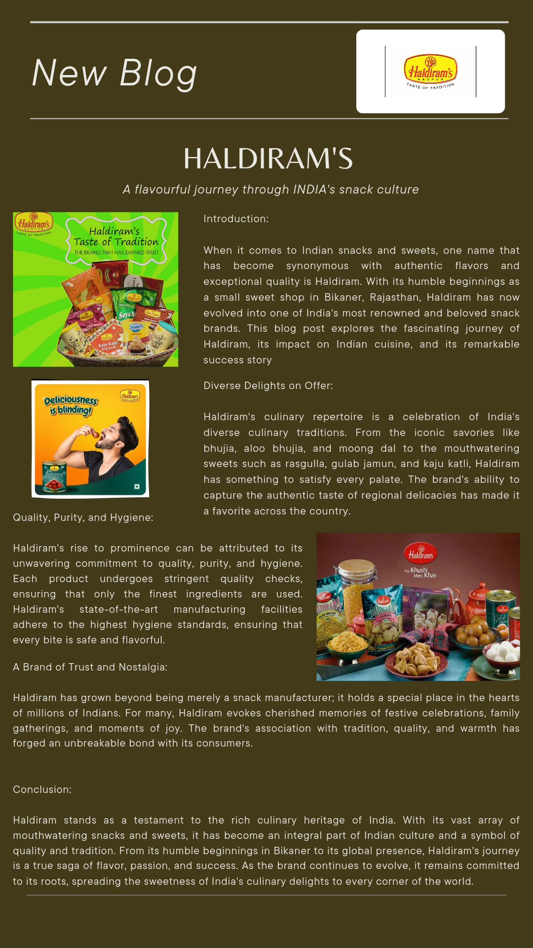
Part 4: Content Creation and Curation (Post creations, Designs/Video Editing, Ad Campaigns over Social Media and Email Ideation and Creation)
Format 1: Blog Article

Slide 23
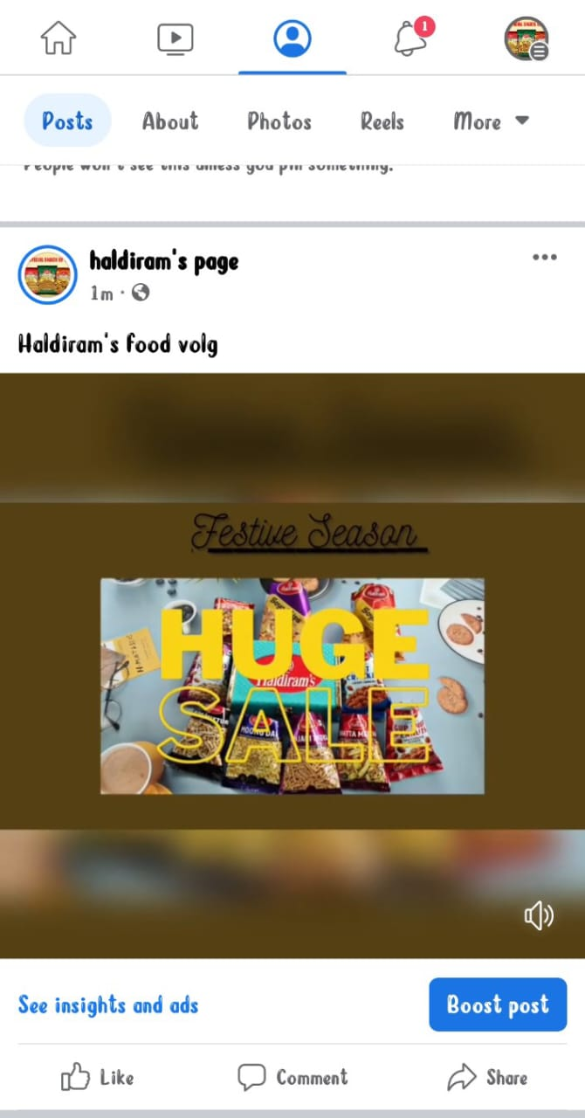
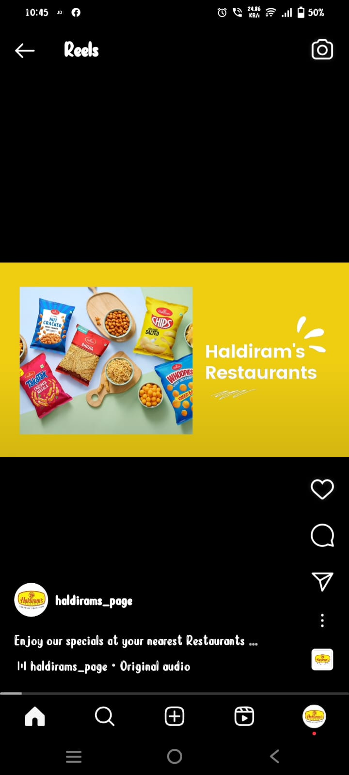
Format 2: video
https://m.facebook.com/story.php?story_fbid=pfbid02Ei8dKLYABciSZbjq86MWiehhgump4qGNt41HEfuxnVeNsvracYAED6jSxE6dMHkSl&id=100095452740355&mibextid=2JQ9oc
https://www.instagram.com/reel/CvOn_HpIvTK/?igshid=MzRlODBiNWFlZA==

Slide 24
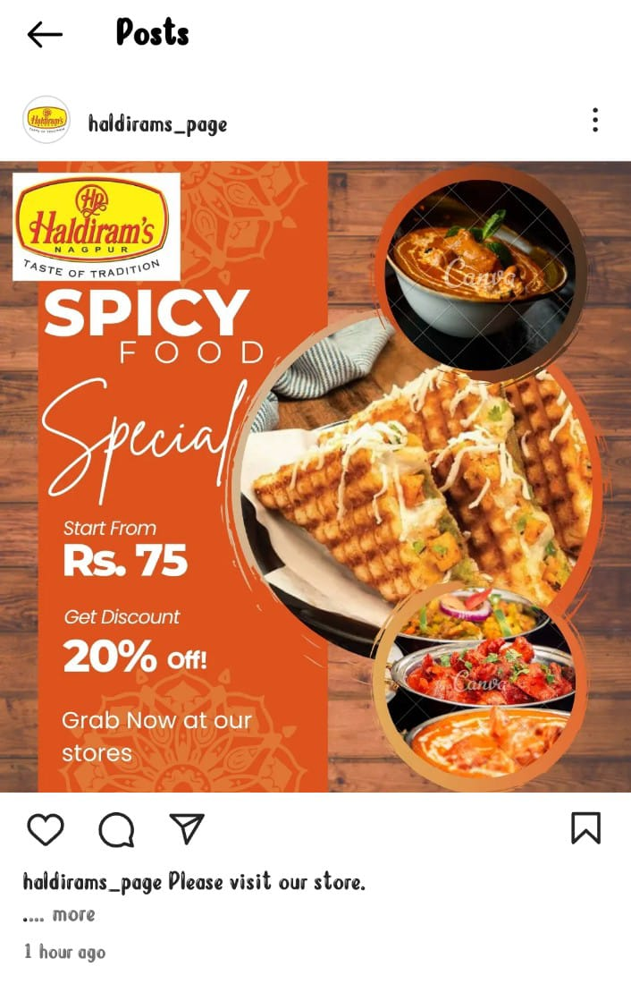
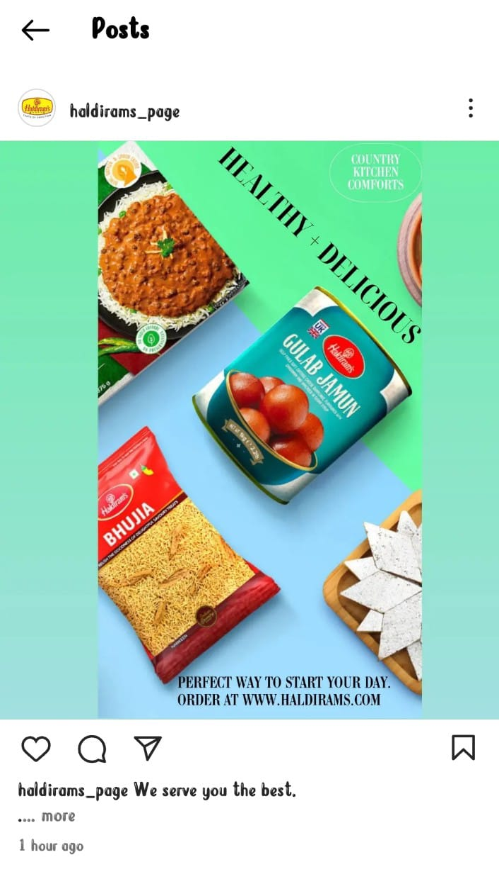
Format 3: Instagram Post (Instagram ID: haldirams_page)
https://www.instagram.com/reel/CvIWm9kIsL4/?igshid=MzRlODBiNWFlZA==
https://www.instagram.com/p/CvOfOV8xNxj/?igshid=MzRlODBiNWFlZA==

Slide 25
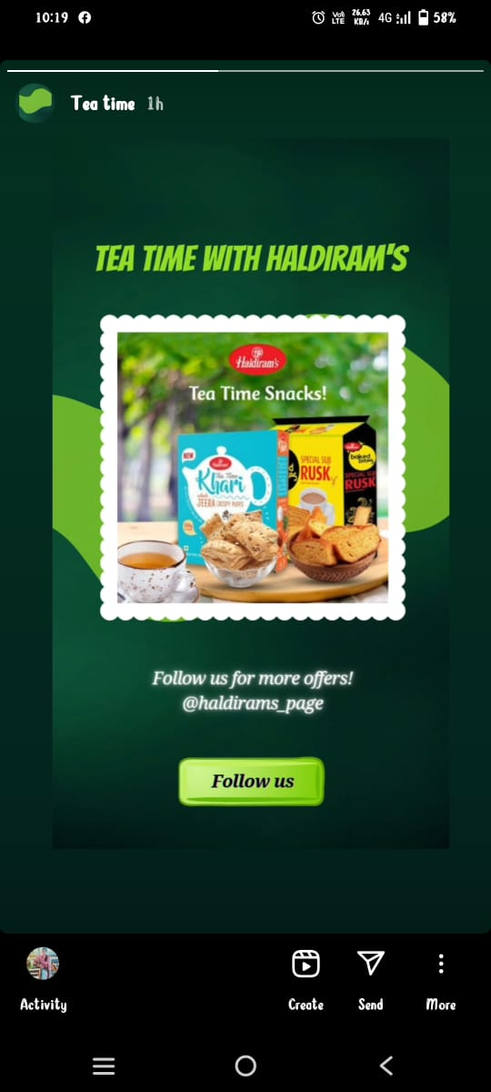
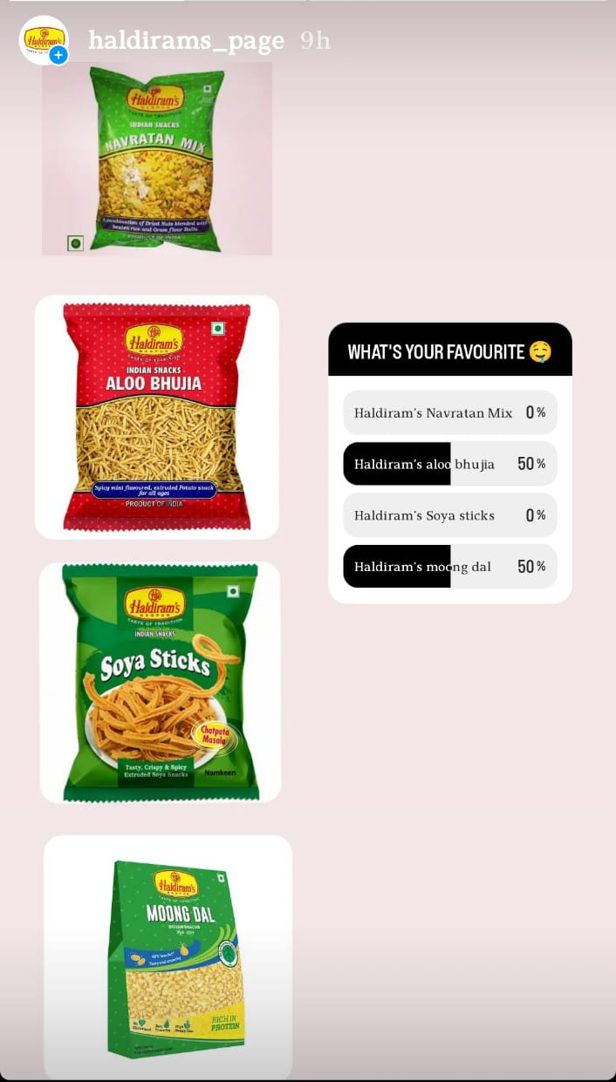
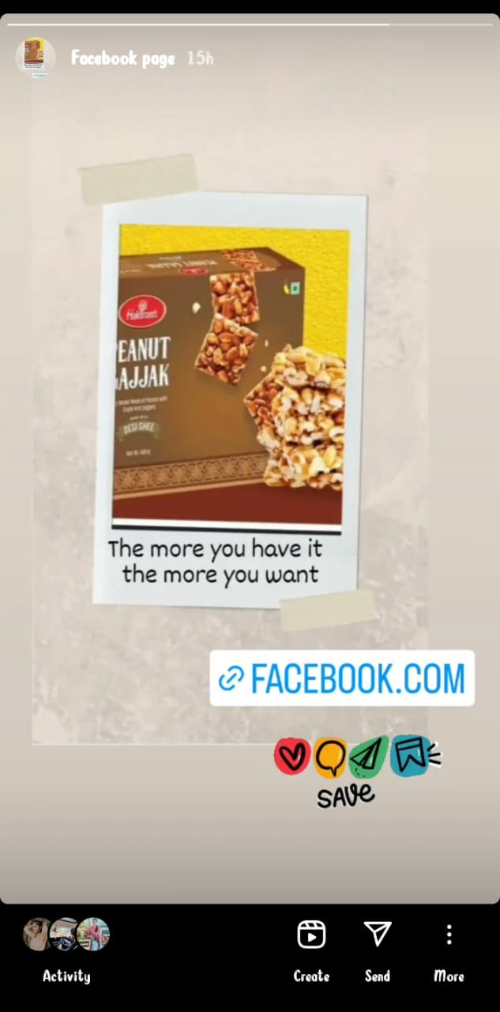
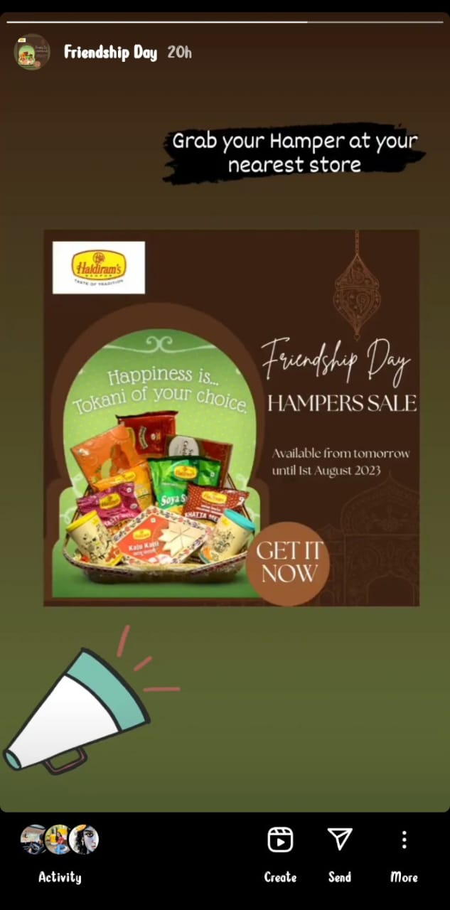
Part 4: Content Creation and Curation (Post creations, Designs/Video Editing, Ad Campaigns over Social Media and Email Ideation and Creation)
Instagram Story
https://www.instagram.com/s/aGlnaGxpZ2h0OjE4MjQyMTI0Mzg1MjA0ODA0?story_media_id=3156592935452251819_60995071476&igshid=MzRlODBiNWFlZA==
https://www.instagram.com/s/aGlnaGxpZ2h0OjE4MDI4MjI2MTA3NTEwMzkz?story_media_id=3152990544410937258_60995071476&igshid=MzRlODBiNWFlZA==
https://www.instagram.com/s/aGlnaGxpZ2h0OjE3OTYzODIzODU3NTQwNDE0?story_media_id=3156185155593310323_60995071476&igshid=MzRlODBiNWFlZA==
https://www.instagram.com/s/aGlnaGxpZ2h0OjE4MDE3Nzc3NDM0NjM1OTMz?story_media_id=3156042588912517307_60995071476&igshid=MzRlODBiNWFlZA==

Slide 26
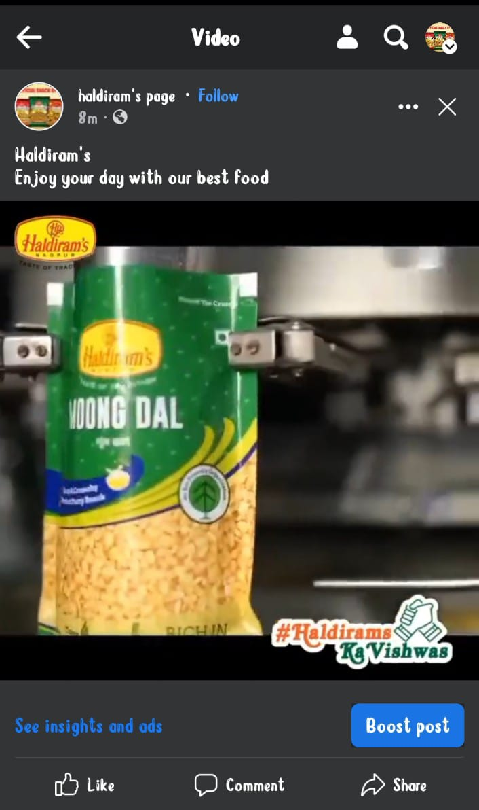
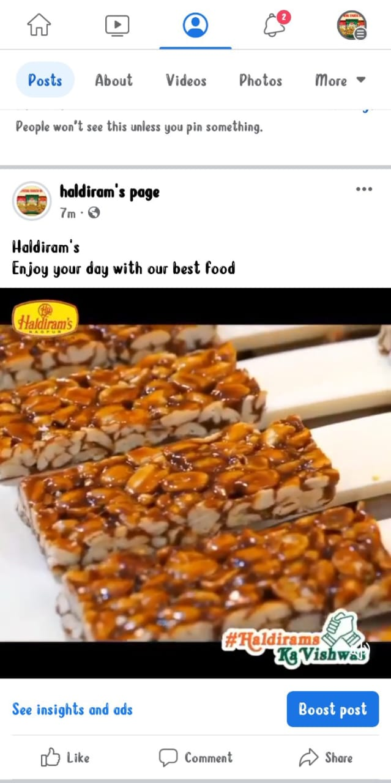
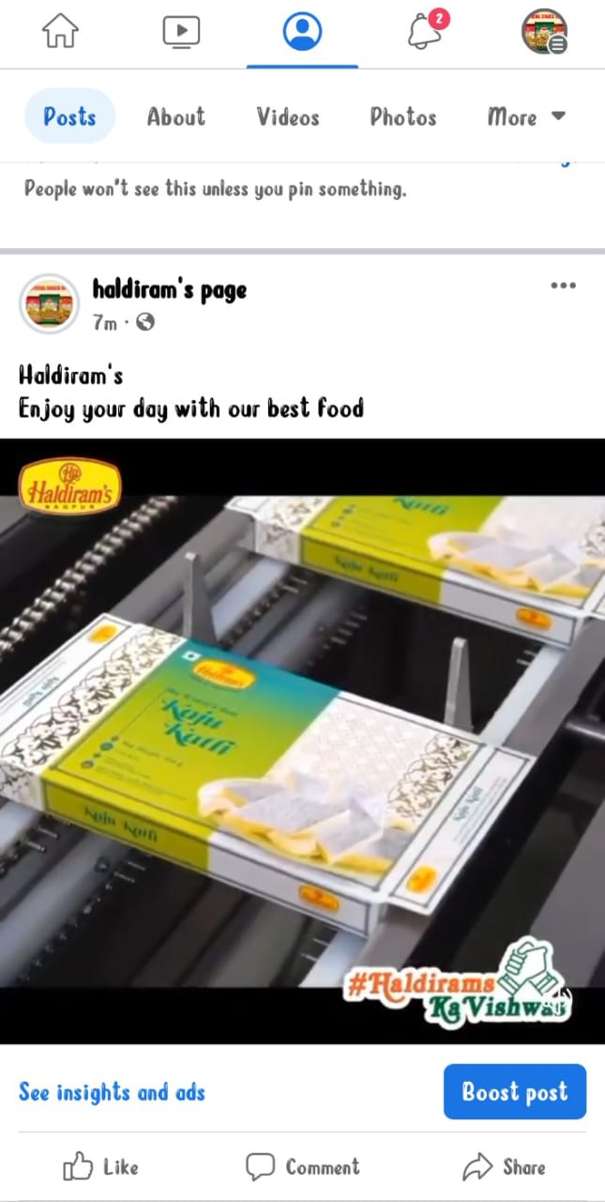
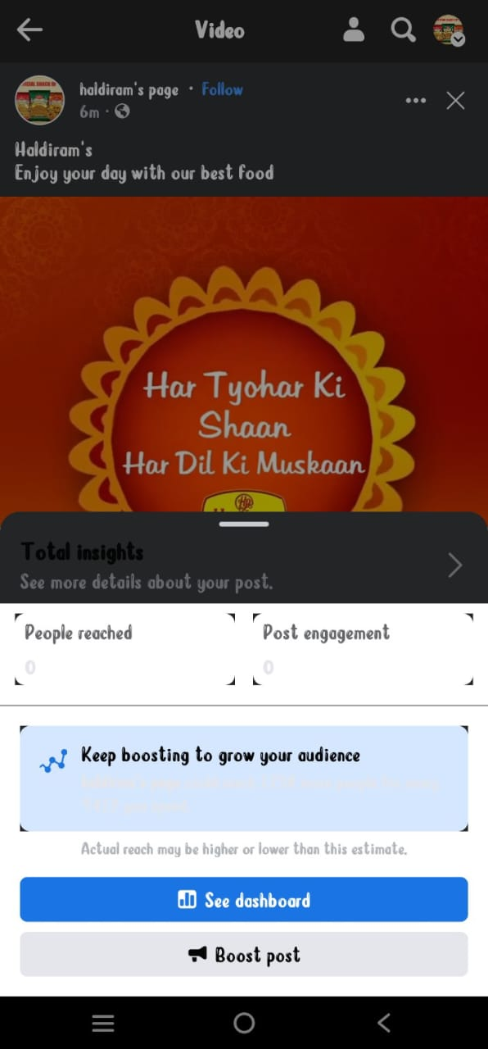
Part 4: Content Creation and Curation (Post creations, Designs/Video Editing, Ad Campaigns over Social Media and Email Ideation and Creation)
Designs/Video Editing
Facebook ID: Haldiram’s page
https://fb.watch/m33H7PR5pI/?mibextid=2JQ9oc

Slide 27
I can offer some general strategies and areas for improvement that businesses often consider to enhance their social media engagement:
Content Relevance and Quality: Ensure that the content you publish on social media is relevant to your target audience and aligns with your brand identity. High-quality content in the form of appealing images, informative videos, and engaging text will likely attract more likes, comments, and shares.
Consistency: Maintain a consistent posting schedule to keep your audience engaged. Regular updates and fresh content will keep your social media presence active and help build a loyal following.
Interactivity: Encourage engagement by asking questions, running polls, or seeking opinions from your audience. Respond to comments and messages promptly, showing that you value your followers' input.
Visual Appeal: Use eye-catching visuals and creative graphics to make your posts stand out. People are more likely to engage with visually appealing content.
Influencer Marketing: Collaborate with influencers or brand advocates who have a significant following in your niche. Their endorsement can boost your brand's visibility and engagement.
Hashtag Strategy: Utilize relevant and trending hashtags to reach a broader audience and increase the chances of being discovered.
Video Content: Incorporate video content into your social media strategy, as videos tend to garner higher engagement rates compared to other content types.
Contests and Giveaways: Host contests or giveaways to incentivize engagement and create excitement among your followers.
Social Listening: Monitor social media channels for mentions, comments, and reviews related to Haldiram's. Engaging with users' feedback and addressing their concerns positively can improve brand perception and loyalty.
Measure and Analyze: Regularly track engagement metrics to understand what type of content performs best and what areas need improvement. Use social media analytics tools to gain insights and optimize your strategy accordingly.
Remember that each social media platform has its unique characteristics and user demographics. Tailor your content and engagement strategies based on the preferences of your target audience on each platform.
It's essential to conduct a thorough analysis of your social media performance regularly, adapt your strategies accordingly, and stay updated with the latest trends in social media marketing to maintain and enhance engagement with your audience.

Slide 28
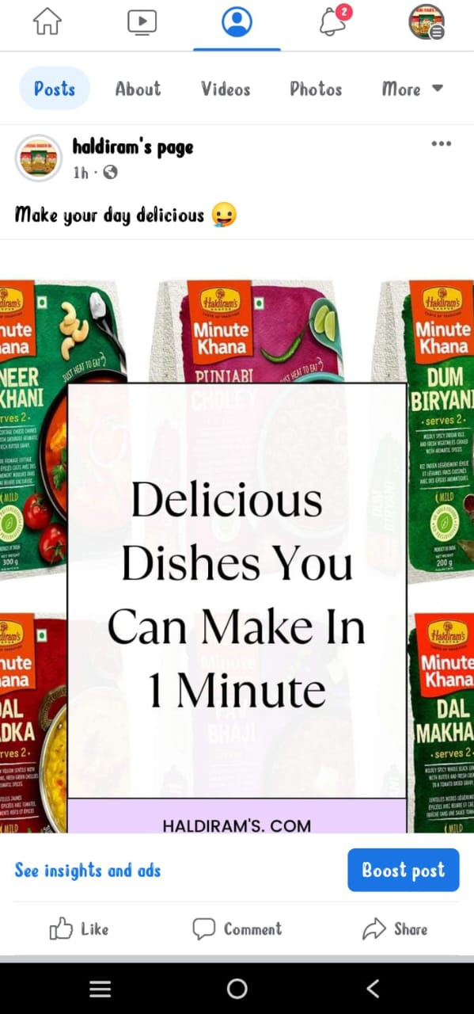
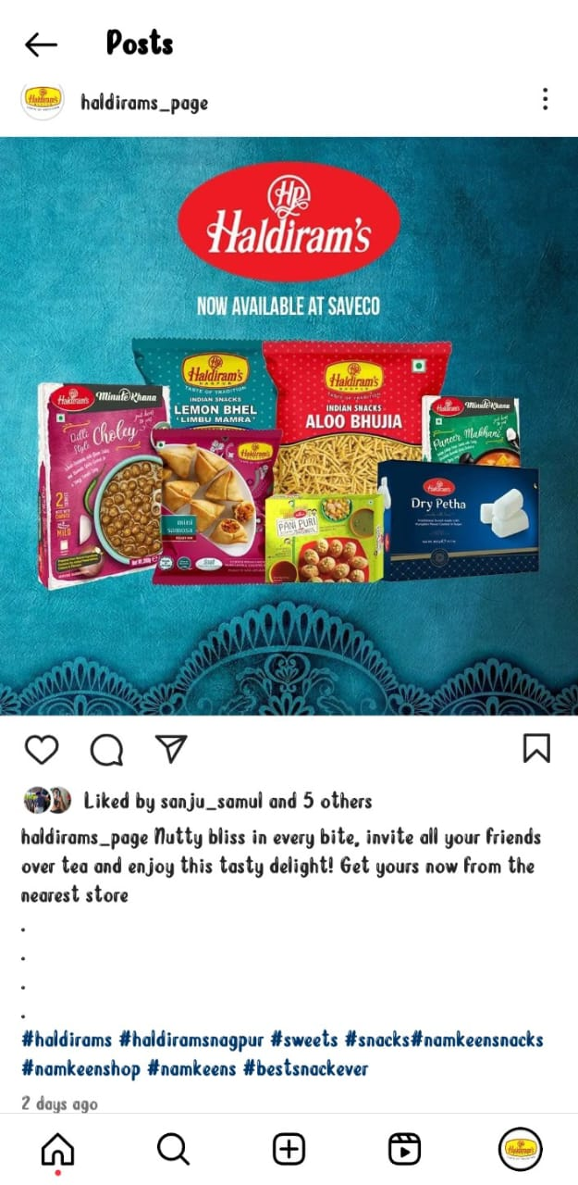
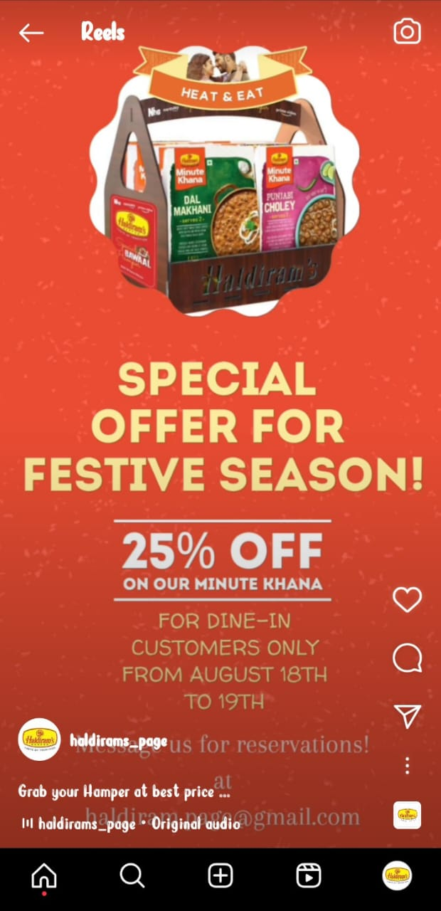
Part 4: Content Creation and Curation (Post creations, Designs/Video Editing, Ad Campaigns over Social Media and Email Ideation and Creation)
Social Media Ad Campaigns
Driving web traffic
Generating
Leads
Brand Awareness
https://m.facebook.com/story.php?story_fbid=pfbid02dzqsHAjr6eL1n5eiyrUXXUEGKAvzt2LXhncnXsEeaBypC4SaKToq8jKDGGa6hmxKl&id=100095452740355&mibextid=2JQ9oc
https://www.instagram.com/reel/CvOto7DoMkm/?igshid=MzRlODBiNWFlZA==
https://www.instagram.com/p/CvIRjn-yIhG/?igshid=MzRlODBiNWFlZA==

Slide 29
Part 4: Content Creation and Curation (Post creations, Designs/Video Editing, Ad Campaigns over Social Media and Email Ideation and Creation)
Advertising Goals: increasing brand awareness, driving website traffic, or generating leads.
Brand Awareness: Increasing brand awareness is a crucial goal for any business, and Haldiram's may aim to reach a broader audience through advertising to make more people aware of their products and offerings.
Product Promotion: Haldiram's might focus on promoting specific products or product lines through their advertising campaigns to drive sales and increase demand for those items.
Expanding Market Reach: If Haldiram's plans to enter new markets or regions, their advertising efforts may concentrate on establishing a presence and gaining market share in those areas.
Building Brand Perception: Advertising can be used to shape how customers perceive the brand. Haldiram's may aim to position itself as a premium, trustworthy, and reliable brand in the snack and sweets industry.
Driving Sales and Revenue: Ultimately, advertising aims to boost sales and generate revenue for the brand. Haldiram's may use advertising to attract new customers, increase repeat purchases, and improve overall sales performance.
Competitive Advantage: Advertising can also be a way for Haldiram's to differentiate itself from competitors and showcase its unique selling propositions (USPs) to customers.
Engaging with the Target Audience: Haldiram's might use advertising to engage with its target audience, encouraging interactions, social media sharing, and customer feedback.
Launching New Products: When introducing new snack or sweet products, Haldiram's may utilize advertising to create excitement and interest around the product launch.
Customer Loyalty and Retention: Advertising can be part of a broader customer retention strategy, reinforcing brand loyalty among existing customers.
Social Responsibility and Corporate Image: Haldiram's might also focus on portraying a positive corporate image and showcasing any social responsibility initiatives they are involved in, as this can resonate with socially conscious consumers.

Slide 30
Audience Targeting: Define the target audience for the ad campaigns based on demographics, interests, and behavior.
However, here are some key audience segments that Haldiram's might have targeted:
Indian Consumers of All Ages: Haldiram's products cater to a wide range of consumers, from children to adults. Their snacks and sweets appeal to various age groups, making them a popular choice among families and individuals.
Snack Enthusiasts: Haldiram's targets people who enjoy snacking on various occasions. Their products are often consumed as snacks during tea-time, movie nights, gatherings, or while traveling.
Indian and Indian Diaspora: Haldiram's products have a strong connection to Indian taste preferences and culture. They may target both Indian consumers within the country and the Indian diaspora worldwide who seek traditional Indian snacks and sweets.
Festive Shoppers: Indian festivals are significant occasions for sharing sweets and snacks. Haldiram's likely targets consumers who indulge in festive shopping to purchase traditional sweets and snacks for gifting and personal consumption.
Health-Conscious Consumers: In recent years, Haldiram's has also introduced healthier snack options, targeting health-conscious consumers who prefer snacks with reduced fat, low sodium, or other nutritional benefits.
Urban and Rural Markets: Haldiram's has a presence in both urban and rural areas of India. They may tailor their marketing strategies to suit the preferences and needs of consumers in these different market segments.
Tourists and Travelers: Haldiram's has established outlets in major tourist destinations, airports, and highways. They may target tourists and travelers who are looking for convenient and familiar snacking options during their journeys.
E-commerce Shoppers: With the rise of online shopping, Haldiram's likely targets consumers who prefer to purchase snacks and sweets through e-commerce platforms.
Corporate Gifting: Haldiram's may also focus on targeting corporate clients who use their products for gifting purposes during festivals and other occasions.

Slide 31
Ad Creation: Create visually appealing ad creatives, compelling ad copy and relevant call-to-action
Therefore, I can provide a general overview of how Haldiram's might approach ad creation based on common advertising practices:
Understanding Brand Identity: Before creating ads, Haldiram's would ensure they have a clear understanding of their brand identity, positioning, and unique selling points. This helps maintain consistency across all advertisements and aligns them with the brand's personality.
Identifying Objectives: Haldiram's would determine the specific objectives of each ad campaign, such as increasing sales, promoting new products, building brand awareness, or targeting a particular audience segment.
Audience Segmentation: They would segment their target audience based on demographics, preferences, behaviors, and other relevant factors. This enables them to tailor their ad messages and visuals to resonate with different audience segments.
Creative Concept Development: The ad creation process would involve brainstorming and developing creative concepts that effectively communicate the key message and capture the audience's attention. This may include visualizing the ads, writing ad copy, and selecting suitable formats (e.g., images, videos, animations).
Showcasing Products: Haldiram's would showcase their snack and sweet products in an appealing way, emphasizing their quality, variety, and taste. This could involve close-up shots of mouth-watering snacks or beautifully presented sweets.
Visual Appeal: The ads would likely focus on high-quality visuals, attractive colors, and eye-catching designs to make the products stand out and leave a positive impression on the audience.
Emphasizing Tradition and Taste: As a brand with strong ties to Indian tradition and taste preferences, Haldiram's might incorporate cultural elements in their ad creation, evoking a sense of nostalgia and familiarity.
Call-to-Action (CTA): Each ad would include a clear and compelling CTA, prompting viewers to take action, such as visiting a nearby store, making an online purchase, or engaging with the brand on social media.
Multi-Channel Approach: Haldiram's would likely adopt a multi-channel approach, creating ads for various platforms like television, print media, online platforms (social media, websites), and outdoor advertising (billboards, banners).

Slide 32
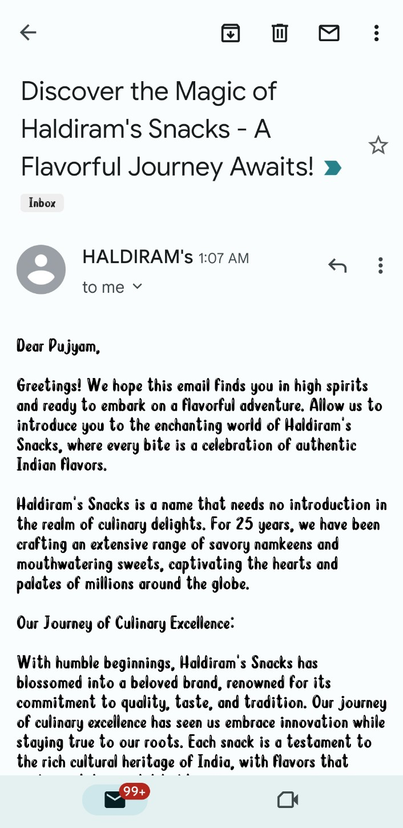
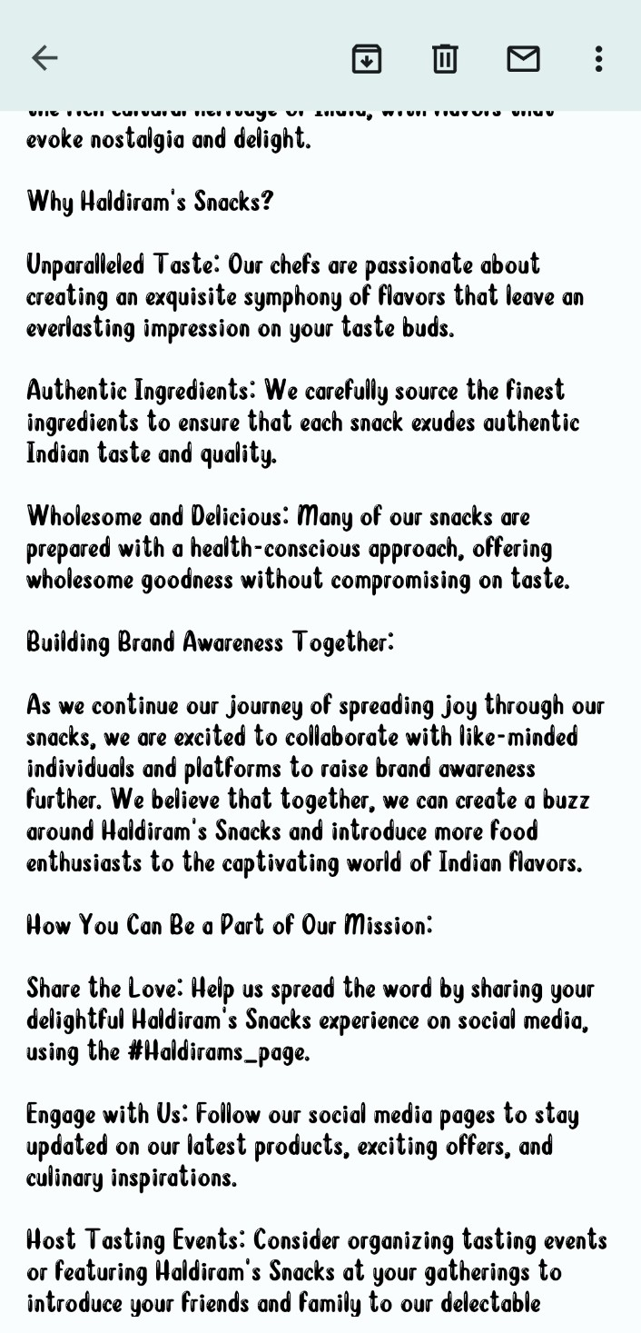
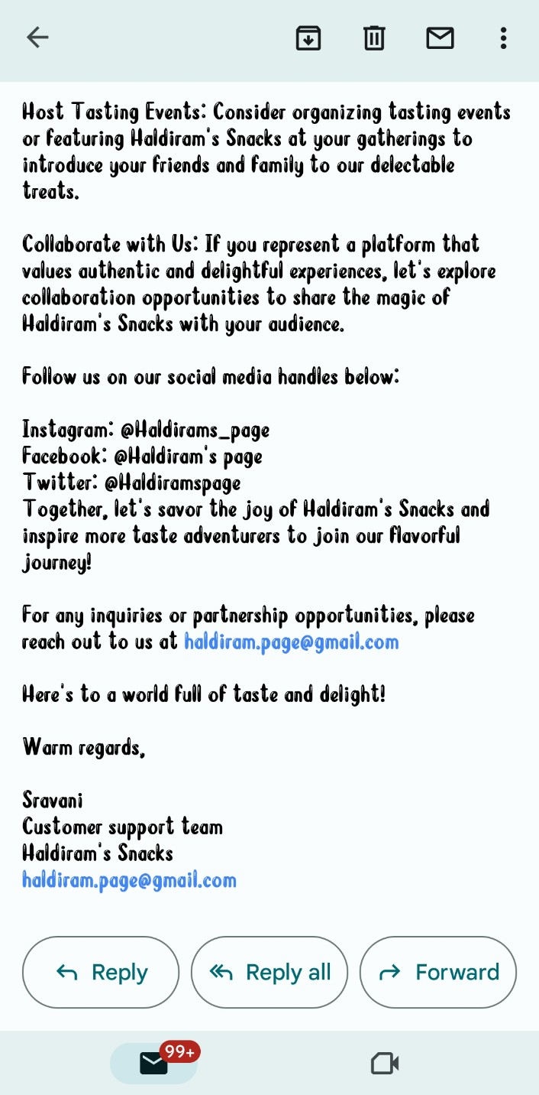
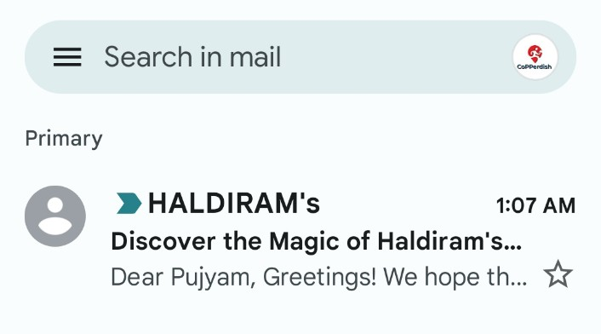
Part 4: Content Creation and Curation (Post creations, Designs/Video Editing, Ad Campaigns over Social Media and Email Ideation and Creation)
Ad Campaigns for email marketing: Come up with 2 email ad campaigns with the mentioned goals: brand awareness & generating leads
Email Ad Campaign 1 –
Brand Awareness
Brand Awareness email to the customer.

Slide 33
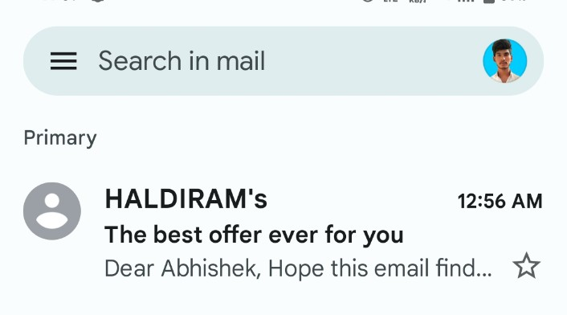
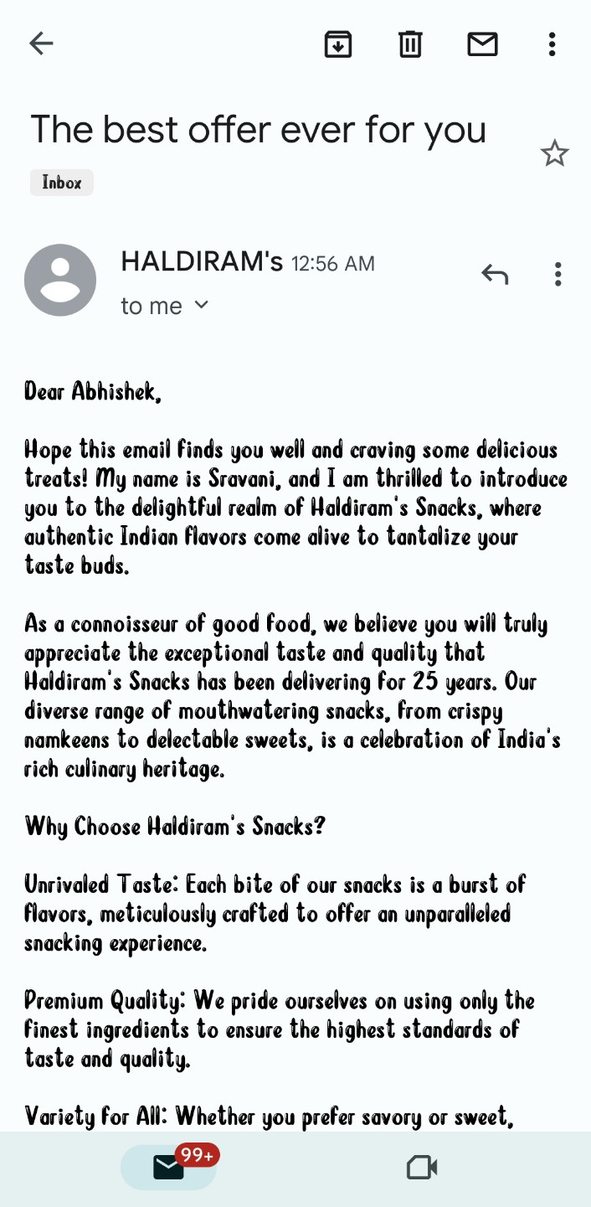
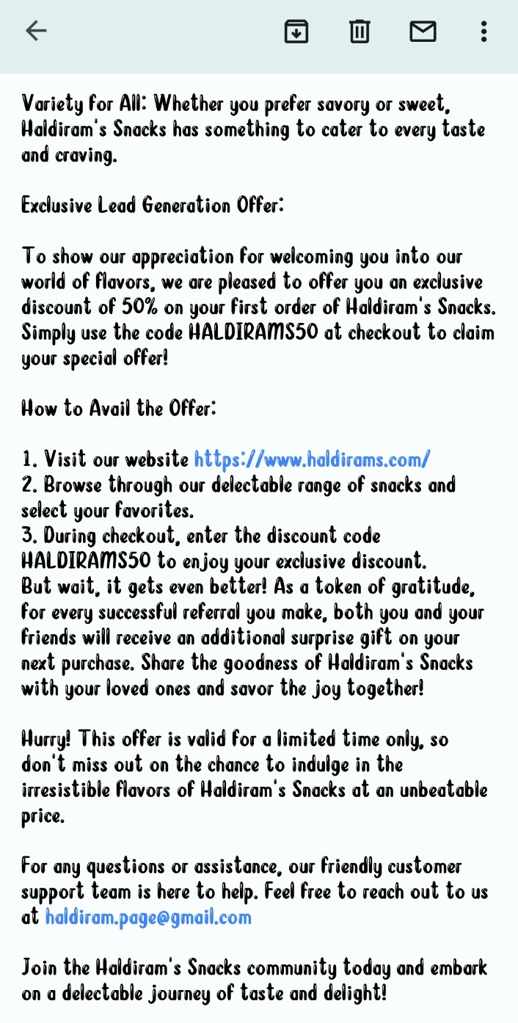
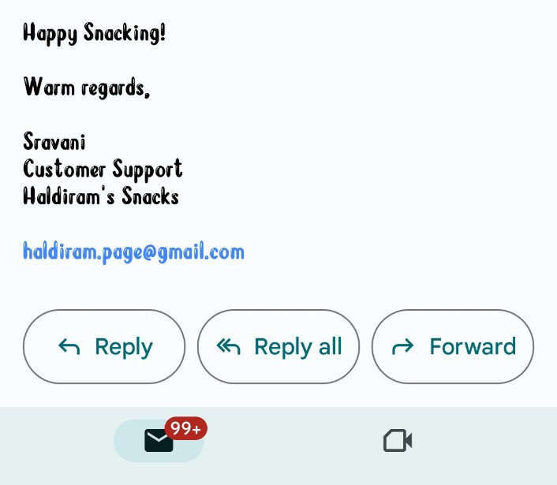
Email Ad Campaign 2 - Lead Generation
Lead generating email to the customer.

Slide 34
Part 4: Content Creation and Curation (Post creations, Designs/Video
Editing, Ad Campaigns over Social Media and Email Ideation and Creation)
However, I can provide some general insights into the challenges and lessons that brands often encounter in content creation and curation:
Content Creation Challenges:
Consistency: One of the key challenges in content creation is maintaining consistency in tone, style, and quality across different channels and platforms.
Creativity and Originality: Keeping content fresh and original can be difficult, especially in a highly competitive market where similar products or services are offered by multiple brands.
Audience Relevance: Understanding the target audience's preferences and interests is crucial. Failing to resonate with the audience can lead to low engagement and reduced effectiveness of the content.
Resource Constraints: Creating high-quality content can be resource-intensive, including the need for skilled writers, designers, photographers, and videographers.
Regulatory Compliance: Brands, especially those in the food industry, need to ensure that their content complies with relevant regulations and advertising standards.
Content Curation Challenges:
Sourcing High-Quality Content: Finding and curating content that aligns with the brand's values and messaging while maintaining quality standards can be challenging.
Rights and Permissions: Ensuring that the brand has the necessary rights and permissions to use curated content is essential to avoid copyright issues.
Relevance and Timeliness: Curated content must be relevant to the brand's audience and the current industry trends. Stale or outdated content may not be well-received.
Balancing Promotion and Value: Curated content should strike a balance between promoting the brand's offerings and providing value to the audience. Overly promotional curation can be off-putting to users.

Slide 35
Lessons Learned:
Know Your Audience: Understanding the preferences, needs, and pain points of the target audience is critical for creating and curating relevant and engaging content.
Consistency and Planning: Developing a content strategy and editorial calendar can help maintain consistency and ensure content is aligned with the brand's goals.
Be Authentic: Authenticity and transparency resonate with audiences. Sharing real stories, experiences, and behind-the-scenes content can strengthen the brand's connection with its followers.
Experiment and Learn: Content creation and curation involve constant experimentation. Analyzing performance metrics and user feedback can provide valuable insights to refine future content strategies.
Leverage User-Generated Content: Encouraging user-generated content and customer testimonials can be an effective way to showcase the brand's popularity and engage with the community.
Monitor Trends: Staying updated on industry trends and user behavior on different platforms can help optimize content creation and curation efforts.
It's important to note that these challenges and lessons are general and may not directly reflect Haldiram's specific experiences. For insights into Haldiram's content creation and curation processes, it would be best to refer to official statements, case studies, or interviews with their marketing team.

